Slide 1
Friendzy
Akhil Kanagala, Manav Modi, Sashank Kannan, Charles Averill, Adrian Requena, Haley Wheatley, Andres Mancillas

Slide 2
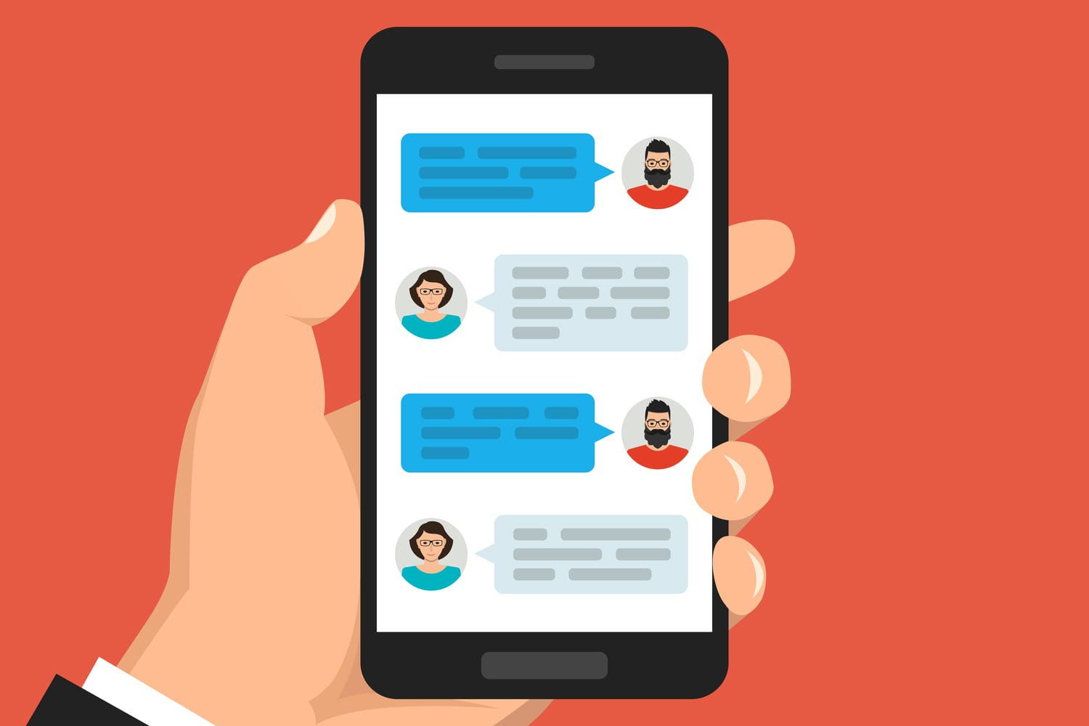
Objective
We decided to create a scheduling app to help users organize their events in a timely and organized manner, while also facilitating connections with other users to create an environment where people feel safe to chat in a community based on similar or different interests.

Slide 3
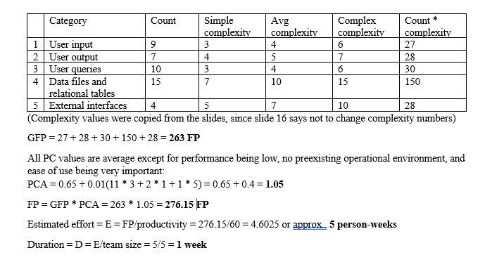
Cost

Slide 4
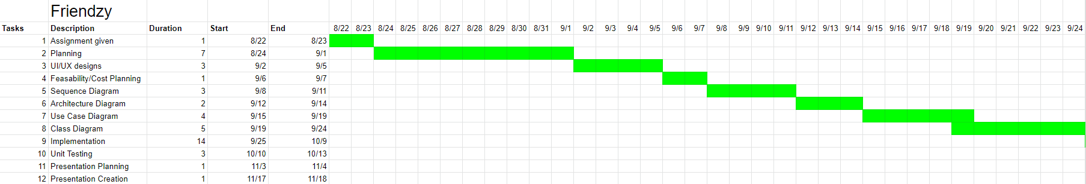
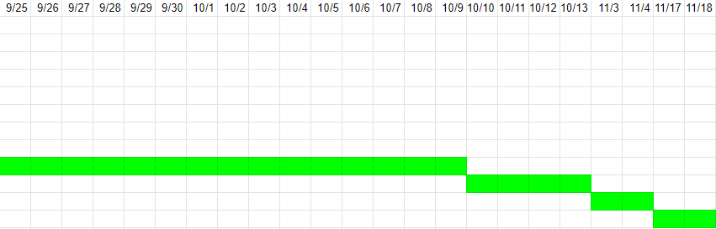
Timeline

Slide 5
Requirements
Non-Functional
Usability: Clear UI/UX
Performance: Live service
Space: With constant updates, clients need to be added to keep up.
Accounting: Premium model, ad revenue
Safety/Security: End-to-end encryption
Environmental: Facilitates connections with other users, creating synergy between them
Operational: Modifying the program overtime to maintain updates and more user interaction
Development: Developers constantly working on the program to keep it functional
Dependability: Maintain the a minimum of resources available so the server can run at all times
Regulatory: Will follow the appropriate laws it would have follow
Ethical: Not sell any schedule information to any companies that are interested in it
Functional
Create a schedule
View other schedules
Find other people
Friend other people
Remove/block friend
Chat with others

Slide 6
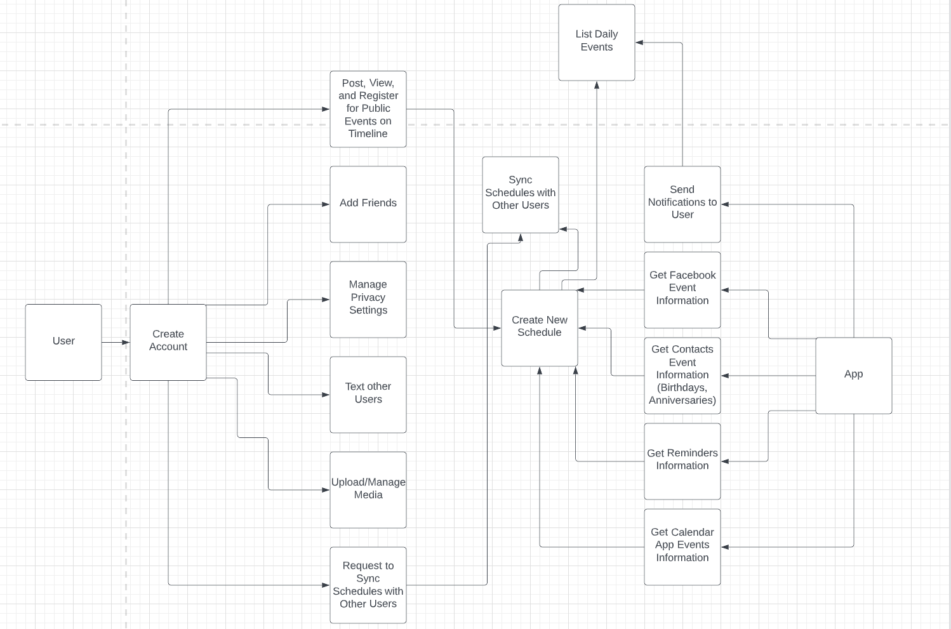
Use Case Diagram

Slide 7
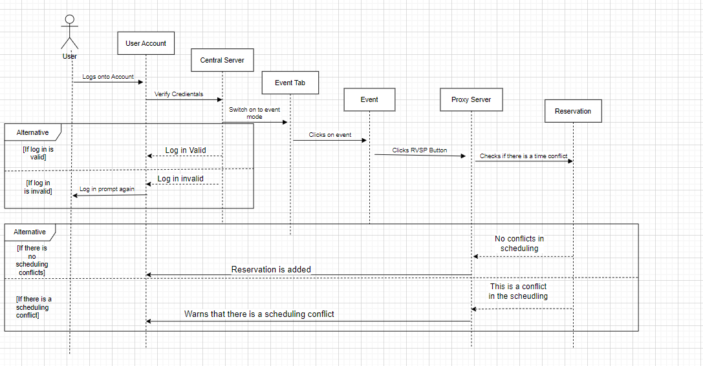
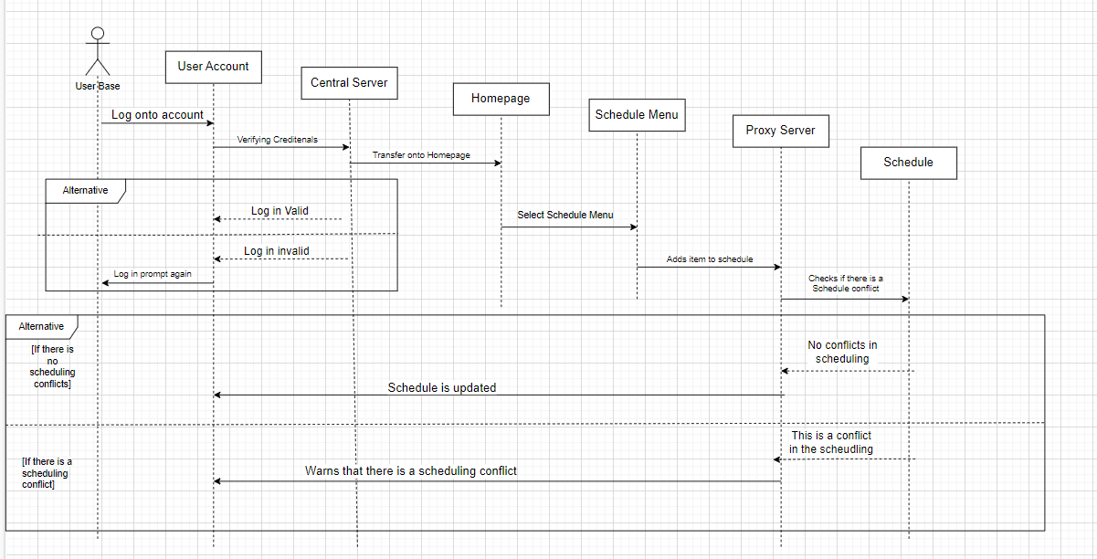
Sequence Diagram
Schedule
Event

Slide 8
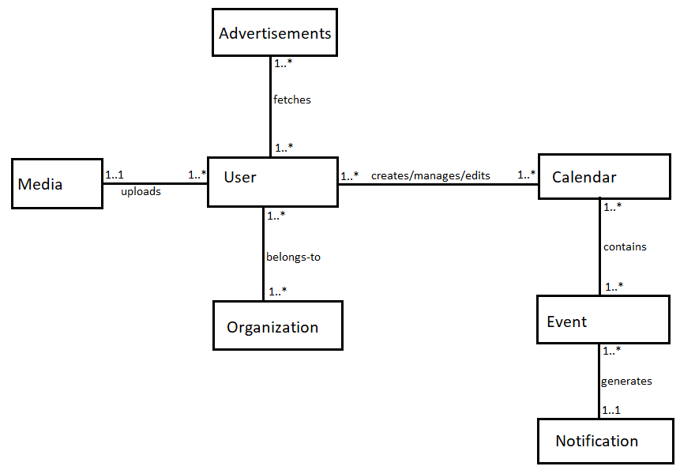
Class Diagram

Slide 9
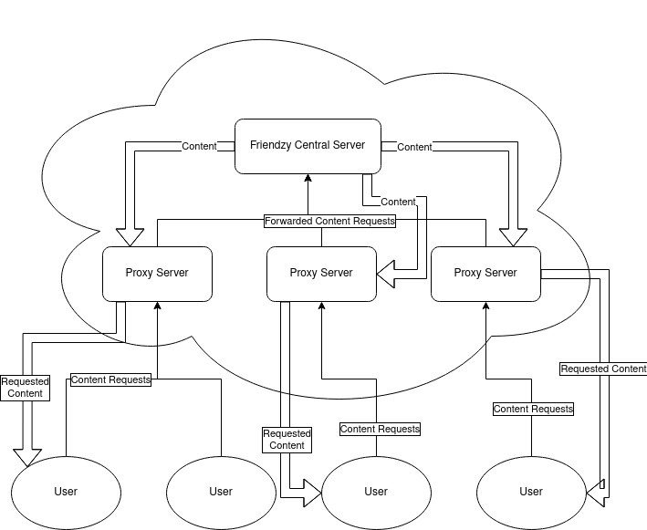
Architectural Design - Client and Server

Slide 10
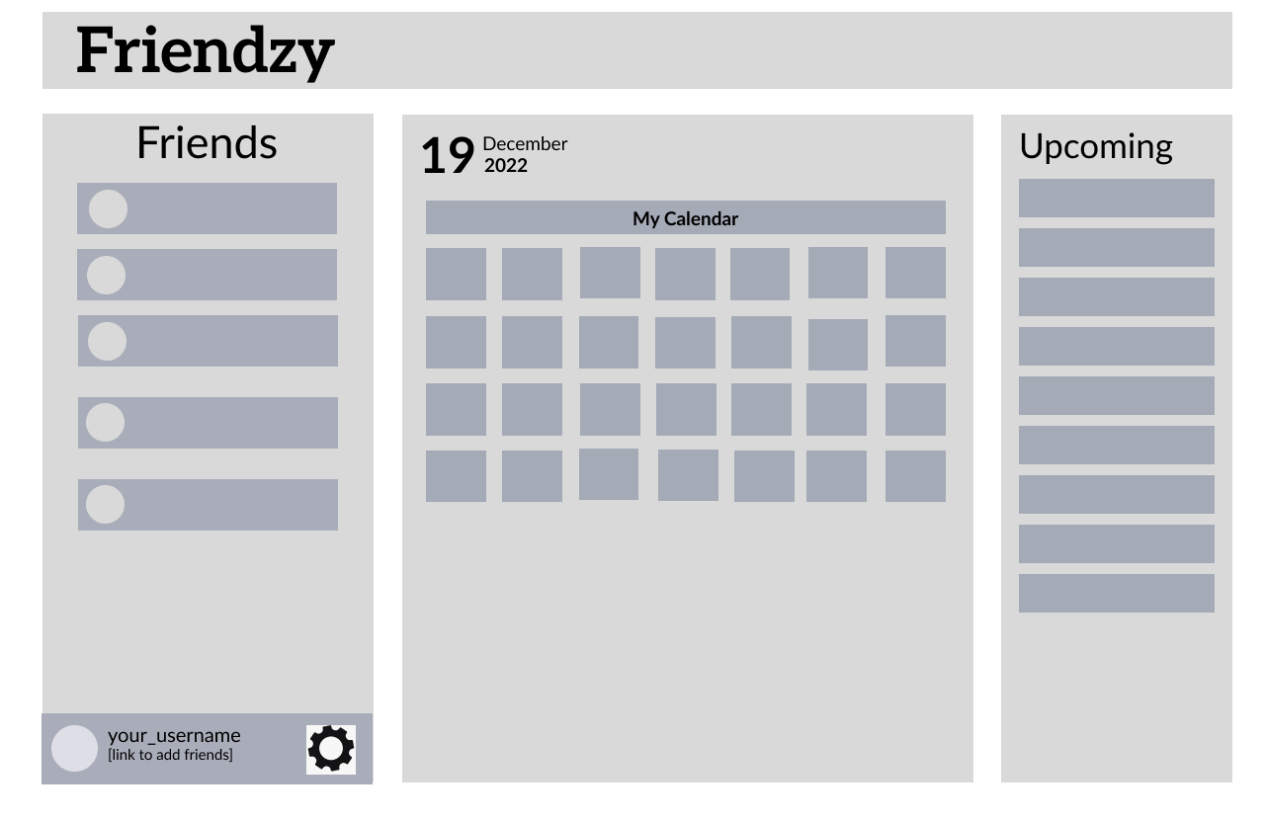
UI Design

